Slide 1
Machine Learning
Lesson 2

Slide 2
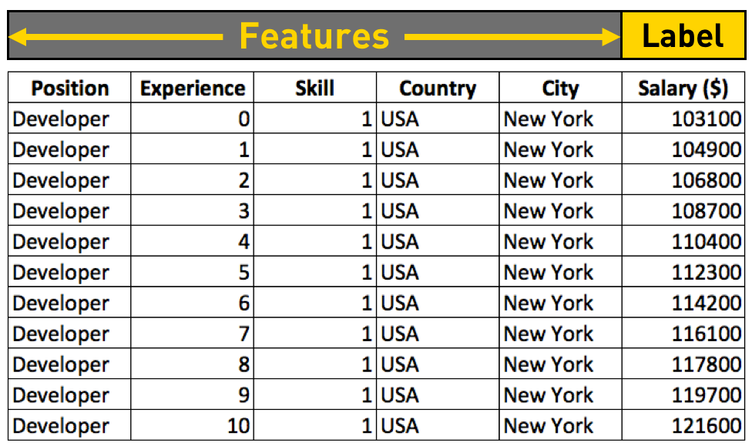
Recap (Features & Labels )

Slide 3
Recap →( Optimizer & Loss Function )
Adjust
( W1, W2, W3 )
Optimizer
X1
Features
W1
Loss/Cost Function
( Ŷ - Y )
Y
( Output/ Label)
X2
Σ
W2
Ŷ
(Predicted Output )
X3
W3

Slide 4
Recap → A Real World Example
Optimizer
Loss = [ Y - Ŷ] = 2
Y
=
12
4
Ŷ= 10
6

Slide 5
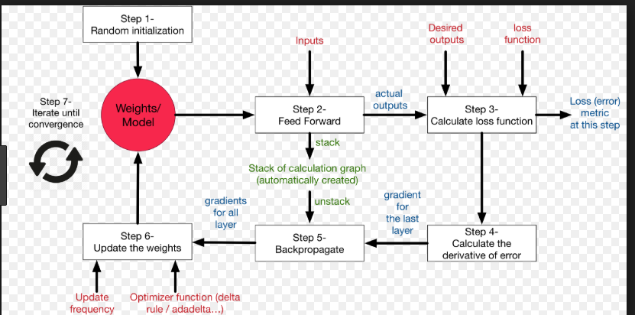
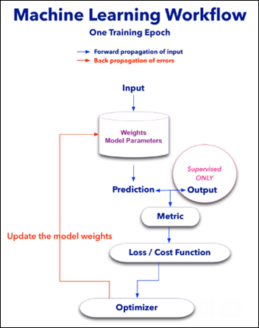
Recap → 3

Slide 6
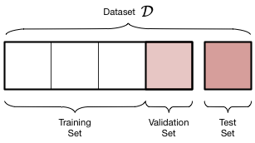
Some More Terminologies

Slide 7
Tools
&
Technologies
( Machine Learning )
Python
Numpy
Pandas
Scikit-Learn

Slide 8
Python
Declaration
Loops
Conditionals
Function
Classes

Slide 9
Numpy
What is Numpy ?
A python library for Array oriented computing
Suited Applications
Image Processing
Machine Learning
A lot of other uses
Foundation of python scientific software Stack

Slide 10
Pandas
What is Pandas ?
Python Library to provide Data analysis features
Components provided by Pandas
Series
Data Frames

Slide 11
Our Focus in Pandas
Data Frames

Slide 12
What is DataFrames ?
A spreadsheet ( excell like ) data structure containing ordered collection of columns
Has Rows and Columns

Slide 13
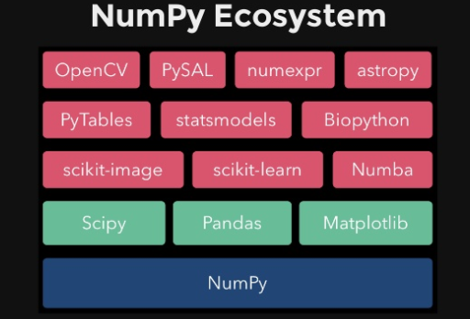
Python Scientific Stack

Slide 14
A Real World
Project
( SMS Spam Filter )
Let’s Jump In

